Slide 1
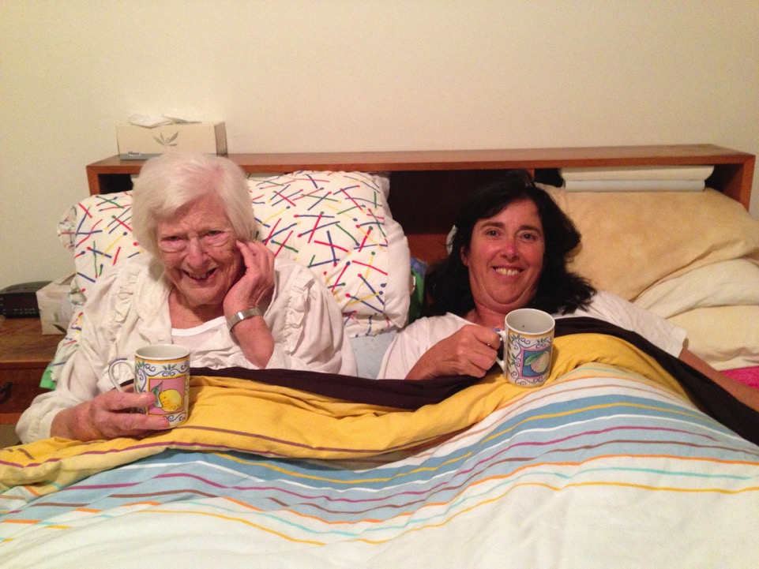
How did someone like me end up in a place like this
Dr Sarah Russell
Aged Care Matters
Notes:
I would like to acknowledge the traditional custodians of the land upon which we meet and thank you very much for the invitation to talk with you.
This morning, I will briefly tell the story about how I stumbled into aged care advocacy and why Ken Wyatt asked me to do a qualitative study on recipients of home care.
My mother and father moved to an aged care home, VBTP, in 2010. They were very happy living at VBTP. Most staff treated them with kindness, respect and love. After Dad’s death in January 2012, I stopped work so I could visit Mum most days for about 3 years until her death in September 2015.

Slide 2
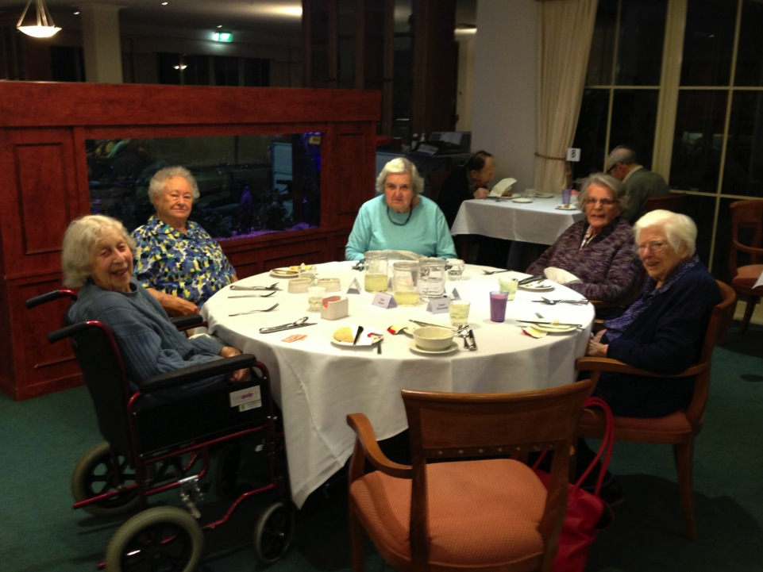
Notes:
I arrived around lunchtime. I would sit at the table with Mum’s friends (that’s my chair). Mum did not have a large appetite – but she was always given a full portion at lunchtime so that I could eat her leftovers. The food was excellent. Certainly better than I can cook.
After I had visited VBTP for about 6 months, the standards of care declined significantly. The decline correlated with a change of manager. 25 relatives got together and I documented all their grievances. I then met with the owner.
The first thing he did was to apologise. I could tell that it was a genuine apology. Then to his credit, he responded quickly and replaced the manager. With a new manager, staff morale improved and standards of care were restored.

Slide 3
The importance of a quick and genuine apology
The importance of the provider taking relatives’ concerns seriously – and taking action
The vital role a manager plays in any aged care home
Notes:
This incident demonstrated 3 things that I think is also important to home care:
The importance of a quick and genuine apology when things go wrong.
The importance of the provider taking relatives’ concerns seriously – and taking action.
The vital role a manager plays in any aged care home.
So this is where my advocacy began.

Slide 4
Notes:
With my background as a public health researcher and an x-registered nurse who had worked in intensive care units, I began to observe life in the aged care home through a critical and clinical lens.
I began analysing systemic issues in the aged care sector and writing regular letters to the editor of The Age. After Mum died, I was asked to write an Op Ed – the editor gave the article the title “The Aged Care Gravy Train’. This Op Ed catapulted me into aged care advocacy.

Slide 5
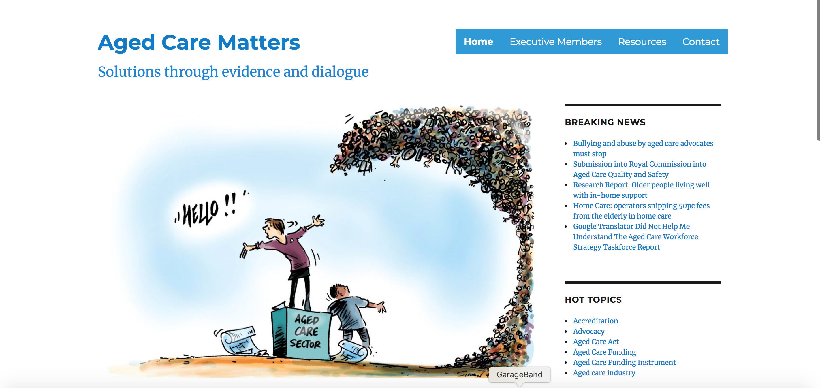
Notes:
I began Aged Care Matters. All voluntary. In addition to writing Opinion Pieces (25 to date), I regularly meet with government, peak bodies, providers. I also receive numerous phone calls from residents and relatives wanting advice and help. And I began a FB group “Aged Care Matters Advocacy Group” that has around 2,500 members – relatives, residents, recipients of home care and staff.

Slide 6
Notes:
I became concerned that the media only reported horror stories about aged care homes. Surely Mum and Dead did not live in the only good aged care home in Australia. So I designed an open-ended questionnaire. I called the project “Living well in an aged care home”. Every time I had a letter or an Opinion Piece published, more people completed the on-line questionnaire. In the end, around 200 people completed the survey.
When Ken Wyatt’s chief advisor read this report, she said something extraordinary: “We had a hunch things were like this in some aged care homes. Every time we visit an aged care home, they put on a nice afternoon tea – also extra staff.” She phoned back the next day and asked if I could do the same type of research (i.e. consumer qualitative research) with those who receive in-home services.
Although I knew nothing about home care I accepted the challenge.

Slide 7
Notes:
This brings me to why I am here today. This report that has made such a splash in the media was submitted to Commonwealth Department of Health at the end of November. It took quite a lot of argy bargy to get the Department to release the report.
When aged care providers do not respond respectfully to feedback, things often escalate to the media. A similar thing happened here. As a result of the Department’s obstructive behaviour, my report received extensive media coverage..

Slide 8
Topics
Client perceptions of the old versus current systems
How clients regard their Case Manager relationship and what’s important to them.
Perceptions of what is a “fair” price for case management and administration.
The views from participants who self managed.
Client perceptions of monthly statements.
The importance to clients of speaking with carers directly rather than via a call centre coordinator.
Client perceptions of what causes large unspent balances.
What are the biggest points of pain for clients and the biggest points of satisfaction.
Notes:
These are the topics that Paul has chosen for discussion:
Before I address these points, I’d like to say that the media has focused primarily on the negative experiences. Surprise surprise.
If you have read the report, you will have noticed that several participants, particularly those who used smaller local for-profit providers, spoke very positively about home care packages and the services they received.
These participants had a case manager who visits them monthly to see how things are going, explains the invoice. They also have support worker who had been specifically matched with them. They felt able to phone/email the case manager anytime (and were confident the case manager would return call/email promptly)
If I had to pick one quote from this long report to sum up my analysis of this study, I would pick this quote:

Slide 9
I could not survive on the home care package without my husband. You have to have a daughter or partner to manage the home care package. (Participant 17)
Notes:
Family and community is very important for living well with a home care package. The things older people found difficult on their own:
My Aged Care
Choosing a provider
Monthly statements
Managing ongoing care.
However, with the assistance of a hospital social worker and the ongoing assistance of an engaged case manager, it seem worked OK.
I will just flag one concern I had with hospital social workers: they recommend the large not for profit faith based providers. My study (small unrepresentative sample) suggests these are often the providers who charge the highest case management and admin fees and deliver the worst support services.

Slide 10
Client perceptions of the old versus current systems
Notes:
Some participants had received in-home care system before and after My Aged Care was introduced in 2013. One participant questioned why the government chose to fix a system that was not broken.

Slide 11
Sometimes I wonder: “Why fix something that’s not broken?” I think it was because the providers were holding on to the cash, and gouging. .. That was when providers were holding on to the money and divvied it up. (Participant 24)

Slide 12
Then out of the blue, I found out that the council had given the contract to Provider K. I am not as comfortable with them. They send young girls who don’t know how to clean. And they often leave messages on my answering machine to change the day and time. (Participant 7)
Notes:
Other participants who had experienced home care before 2013 were oblivious to any systemic reforms. The only things that concerned them was they were now registered with My Aged Care. Some were upset their local council no longer delivered services.
In fact several participants said they would have preferred their local council to deliver the support. One participant had cared for her husband with dementia for many years using the local council support. She said they were wonderful. She had now reached an age when she needed support herself – but found the local council had outsourced the services to [name of provider].
She was angry about this because she didn’t think they were nearly as reliable or good.

Slide 13
‘Claytons’ Consumer Directed Care
I didn’t have any say in how the funds [in my home care package] were spent. They don’t want to let you know very much. They don’t sit down with you and explain what you’re entitled to. They don’t spell it out to you. (Participant 17)
Notes:
Participants who had received in-home care for many years said the new system gave the ‘consumer’ more control than in the past. However, they did not have full control over how their home care package was spent. They said the provider still controlled what they could have and what they couldn’t.

Slide 14
How clients regard their Case Manager relationship and what’s important to them
Notes:
In my view the case manager is the linchpin. They help to create a good workplace for the support workers but can also play a pivotal role- particularly for those who don’t have any family support.
In-home care has a very steep learning curve. So not surprisingly several participants described the case manager as integral to the quality of the service, particularly in the early days of receiving a home care package.
The data I collected about a “good case manager” reminded me of a “good manager in and aged care home”. They were primarily responsible for the delivery of high standards of support and care.
Participants said they valued case managers who provided information about services and other entitlements.
They also appreciated case managers who visited their home regularly. These case managers made suggestions about support services, including recommending an assessment for a higher-level package when an older person’s health deteriorated and/or needs increased.

Slide 15
The case manager is very informative. She comes out once every three months to see how things are going. Each time she reminds me of things I am entitled to have. She recommends I leave my hours as they are so I can accumulate some funds to get the equipment I may need down the track. She is really good. (Participant 28)
Notes:
Participants were grateful when they were able to form positive relationships with case managers. They considered themselves lucky when they had the same case manager for a considerable length of time.
They appreciated case managers who were easy to contact and responded promptly to phone calls and emails.
Several participants said they were happy to pay case management fees if the case manager provided a worthwhile service. However, several participants never even saw their case manager, and hardly ever spoke to them on the phone. Some participants became aware they had a case manager when they saw the fees on their financial statement. They questioned why they were charged case management fees when they received no case management.
As recipients of care, they are, of course, not aware of what goes on behind the scenes.

Slide 16
I was told the mainstream provider charged $90 when you phoned the case manager. You wouldn’t want to be charged that ridiculous amount. So you wouldn’t phone. You’d go without. (Participant 41)
Notes:
An Indigenous participant described why she did not phone the case manager.
I was told the mainstream provider charged $90 when you phoned the case manager. You wouldn’t want to be charged that ridiculous amount. So you wouldn’t phone. You’d go without. (Participant 41)
A participant raised an important point - She was concerned how case managers would know to arrange an assessment for a higher-level home care package if they didn’t visit regularly.

Slide 17
Perceptions of what is a “fair” price for case management and administration.

Slide 18
In concept, the home care package is fantastic. Brilliant. But there are not enough hours in it. These service providers are ripping off the government. (Participant 14)
Notes:
Some participants took a cynical view. Their position was ALL the for-profit providers were “ripping” off the government. They thought home care packages should not be delivered by providers making a profit.

Slide 19
Providers have got superannuation, workers compensation, public liability and professional indemnity – looking at wages plus 15 per cent. You’ve got to give the agency something. So my view is about 20 per cent. So if they are charging any more than 35 per cent, I query it.
Notes:
Other participants appreciated providers ran a business and needed to make a profit to stay in business.
Providers have got superannuation, workers compensation, public liability and professional indemnity – looking at wages plus 15 per cent. You’ve got to give the agency something. So my view is about 20 per cent. So if they are charging any more than 35 per cent, I query it.
Participants wondered whether costs were inflated because home care packages were subsidised by the government. This seems a reasonable comment after the pink batts saga and the problems we’ve seen with privatizing vocational education. But neither of these industries had the same level of regulation that aged care services

Slide 20
The views from participants who self managed
Notes:
Two participants in the sample self managed.

Slide 21
The self-managing is like a gift from heaven. I do not have that middleman. So I can create space for just the carer and myself to make my own arrangements as we see fit. (Participant 17)
Notes:
72-year-old married woman with myalgic encephalomyelitis. She had been with [name of provider]– and felt she was being charged exorbitant fees and hourly rates for support workers. She was extremely intelligent woman. She described moving to self management as “wonderful”.

Slide 22
The reliability of private carers is brilliant because I hired them and have gotten to know them. (Participant 3)
Notes:
Second participant: 75 year old woman with dementia whose daughter had stopped work so she could help her mother to continue to live at home alone. Her mother lived in St Kilda and daughter in North Fitzroy. Initially they were clients of [name of provider]. The daughter realised they were taking around 53% of a Level 2 package. So when Mum was assigned a Level 4 package, she moved to self managed had become an expert in home care packages.
Both participants employed support workers via an internet platform Mable. They considered the hourly rates more reasonable than the hourly rates they had paid their previous provider. They both received many more hours of support. They also described continuity of support workers that enabled relationships to develop. Home care is relationship based. So the thing participants valued the most were the relationships the formed.
They felt in control of how package was spent – The participant who managed her mother’s home care package described spending the money “creatively” to assist her mother’s quality of life.
The also described less difficulty getting things they needed. The didn’t have to “fight” with providers.
(A very good question from member of Leadership Team that raised the issue of financial elder abuse, something I had not considered.)

Slide 23
Client perceptions of monthly statements
Notes:
Where do I start with the problems with monthly statements. Suffice to say, participants described lots of problems.

Slide 24
We didn’t understand the statement. Nobody explained. We asked the case manager to explain. She couldn’t understand it either. (Participant 12)
Notes:
The most common complaint was the monthly financial statements were “difficult to understand”.
We didn’t understand the statement. Nobody explained. We asked the case manager to explain. She couldn’t understand it either. (Participant 12)
Support people described the recipients, particularly those with dementia, having difficulties understanding the monthly financial statements. But the children also said they should not need a university degree to understand their parents’ monthly statements. Participants suggested the case manager explain the monthly statement to those who had trouble understanding it.
Several participants noticed financial anomalies on their statements. A common anomaly was being charged for services they had not used.
Participants also described a need for real-time access to statements so recipients know their balance.

Slide 25
The importance to clients of speaking with carers directly rather than via a call centre coordinator
Notes:
Some large providers have a centralised administration. Participants said this made communication difficult for the older person and their family.

Slide 26
Having to go through a bureaucratic system to get a message to my carer is a stumbling block for me. If I want to say: “I don’t need [Name] this week because I have a meeting somewhere,” I can’t say to [Name] – well I do say it anyway. But it has to go through the system. (Participant 41)
Notes:
Participants wanted to form relationships, particularly with their direct care support workers. They did not like having to phone an anonymous person and leave a message. They described it as impersonal and inefficient, particularly when the message was not relayed to the support worker.

Slide 27
Client perceptions of what causes large unspent balances

Slide 28
Preferring family carer
Provider did not supply the services required
Unhappy with the quality of the services
Saving their money for a later date (e.g home modifications)
Anticipated not being able to access a Level 4 HCP when it was required
Delays in the primary provider receiving the secondary provider’s invoice
Notes:
Participants described several reasons for having a large surplus in their package.
One participant described her mother preferring her family over professionals to provide the support.
Several participants described being unable to spend their home care package because the provider did not supply the required services.
Some participants described not using the services because they were unhappy with the quality of the services delivered.
Several participants were saving their money for a later date when they would require equipment or house renovations.
A participant was saving the package because she anticipated her father would not be able to access a Level 4 home care package when it was required.
Some participants had a temporary surplus because they used services from another provider. The surplus in their account was due to delays in the primary provider receiving the secondary provider’s invoice.

Slide 29
What are the biggest points of pain for clients
Notes:
We hear a lot abut My Aged Care, invoices, fees, not enough hours of support, not knowing entitlements. So I want to give you 3 things you don’t hear much about.

Slide 30
The trouble when you first start out with all this is too much information. It’s all given to you in pamphlets. (Participant 28)
Notes:
At the beginning of their “journey”, several participants described being inundated with information.
The trouble when you first start out with all this is too much information. It’s all given to you in pamphlets.
Despite all these numerous fact sheets, brochures and pamphlets, participants had many questions. They described finding it difficult to get reliable and consistent information.

Slide 31
The providers use typical marketing ploys. When I read all their glossy brochures, I thought “wow”. Provider E advertise “trained carers”. After Dad signed the contract, they phoned me to say they had no carers and would have to outsource for carers. (Participant 19)
Notes:
The second point is providers who give misleading advertisements about home care services.
The providers use typical marketing ploys. When I read all their glossy brochures, I thought “wow”. Provider E advertise “trained carers”. After Dad signed the contract, they phoned me to say they had no carers and would have to outsource for carers. (Participant 19)
Thirdly, Participants were also concerned that some providers accepted too many clients without hiring enough staff. They were unable to deliver the services that participants expected.

Slide 32
What are the biggest points of satisfaction for clients
Notes:
Support workers - Genuine friendships developed
Participants appreciated knowing in advance who would be working in their home and when they were expected to arrive.
And they appreciated support workers who turned up on-time.
Participants appreciated support workers and service providers who were flexible.
Person-centred care
Some participants described their experiences of person-centred care. Participant 40 was thrilled when the home care package provider agreed to allow her father’s support worker to be with him when he visited his wife in an aged care home. During her shift, the support worker is responsible for the father and the aged care home is responsible for the mother. The participant was delighted when the provider and aged care home gave permission for the support worker to take the mother and father for outings.

Slide 33
I am very grateful for this package. It has enabled me to live in my home. Without these services, I wouldn’t have been able to stay here. I couldn’t do it all myself. I am delighted with the help I get. It has been a godsend. (Participant 18)

